Slide 1

Vehicles chasing each other around
a closed course with varying properties

Slide 2

Lane Detection Subsystem
Problem
Detecting lane lines out of a captured image in real time
DUAYENLER

Slide 3
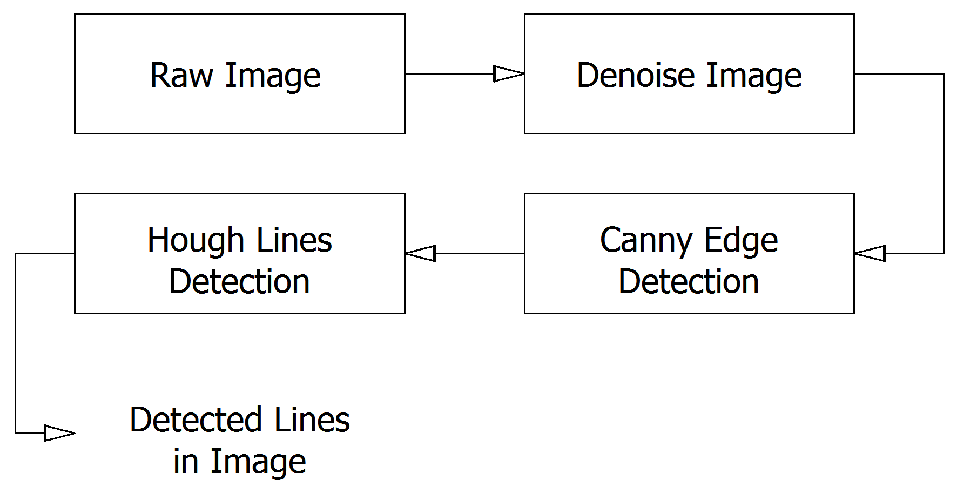
Lane Detection Subsystem
Solution
DUAYENLER

Slide 4
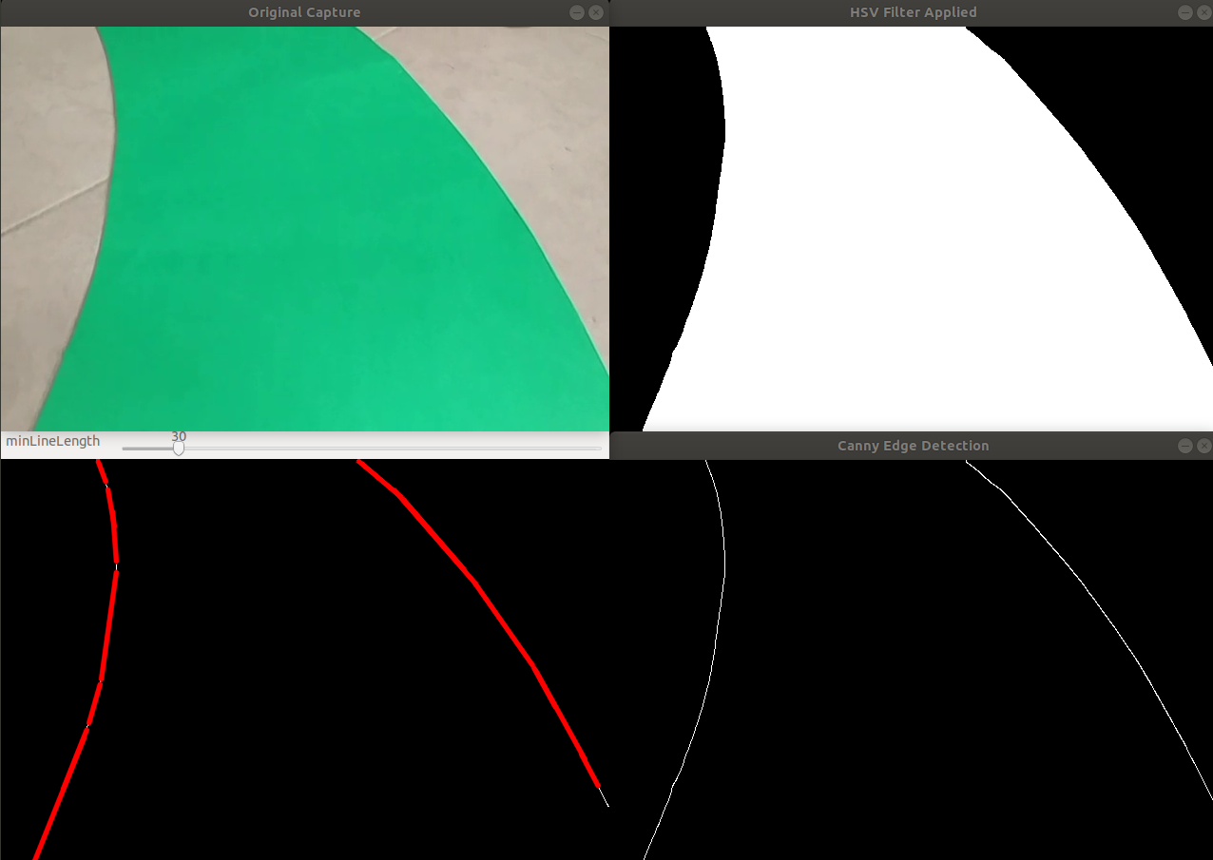
Lane Detection Subsystem
Sample Outputs of Color Filtering, Canny Edge Detection and Hough lines
DUAYENLER

Slide 5
Data Processing Subsystem
Problem
Determining the turn angle and direction out of the found lines in the image
DUAYENLER

Slide 6
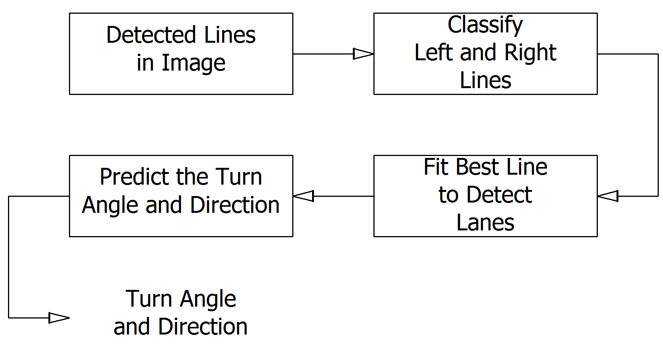
Data Processing Subsystem
Solution
DUAYENLER

Slide 7
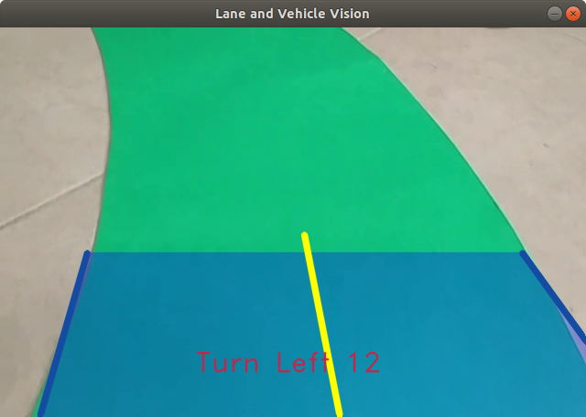
Data Processing Subsystem
Sample Output of Data Processing Subsystem
DUAYENLER

Slide 8
Lane Vision of the Vehicle
Sample Realtime Video Containing the Turn Angle and Direction
DUAYENLER

Slide 9
Power consumption
 | Current (avg) A | Watt(avg) W | Current (max) A | Watt(max) W
Raspberry pi | 0,85 | 4,25 | 2,5 | 12,5
Arduino | 80m | 0,4 | 0,2 | 1
Driver and DC Motors | 1,5 | 18 | 3 | 36
ToF sensors | 19m | 62.7m | 40m | 132m
Total power consumption | 2,45 | 22,71 | 5,74 | 49,6

Slide 10
Cost Analysis
Component | Price ($)
Raspberry pi | 48
Arduino | 5
Driver and DC Motors | 24.5
ToF sensors | 18
Wheels | 8
Powerbank | 12
Li-po Battery | 15
Additional components | 10
Additional payment | 15
Camera | 23
Chassis | 20
Total Project | 198,5

